Slide 1

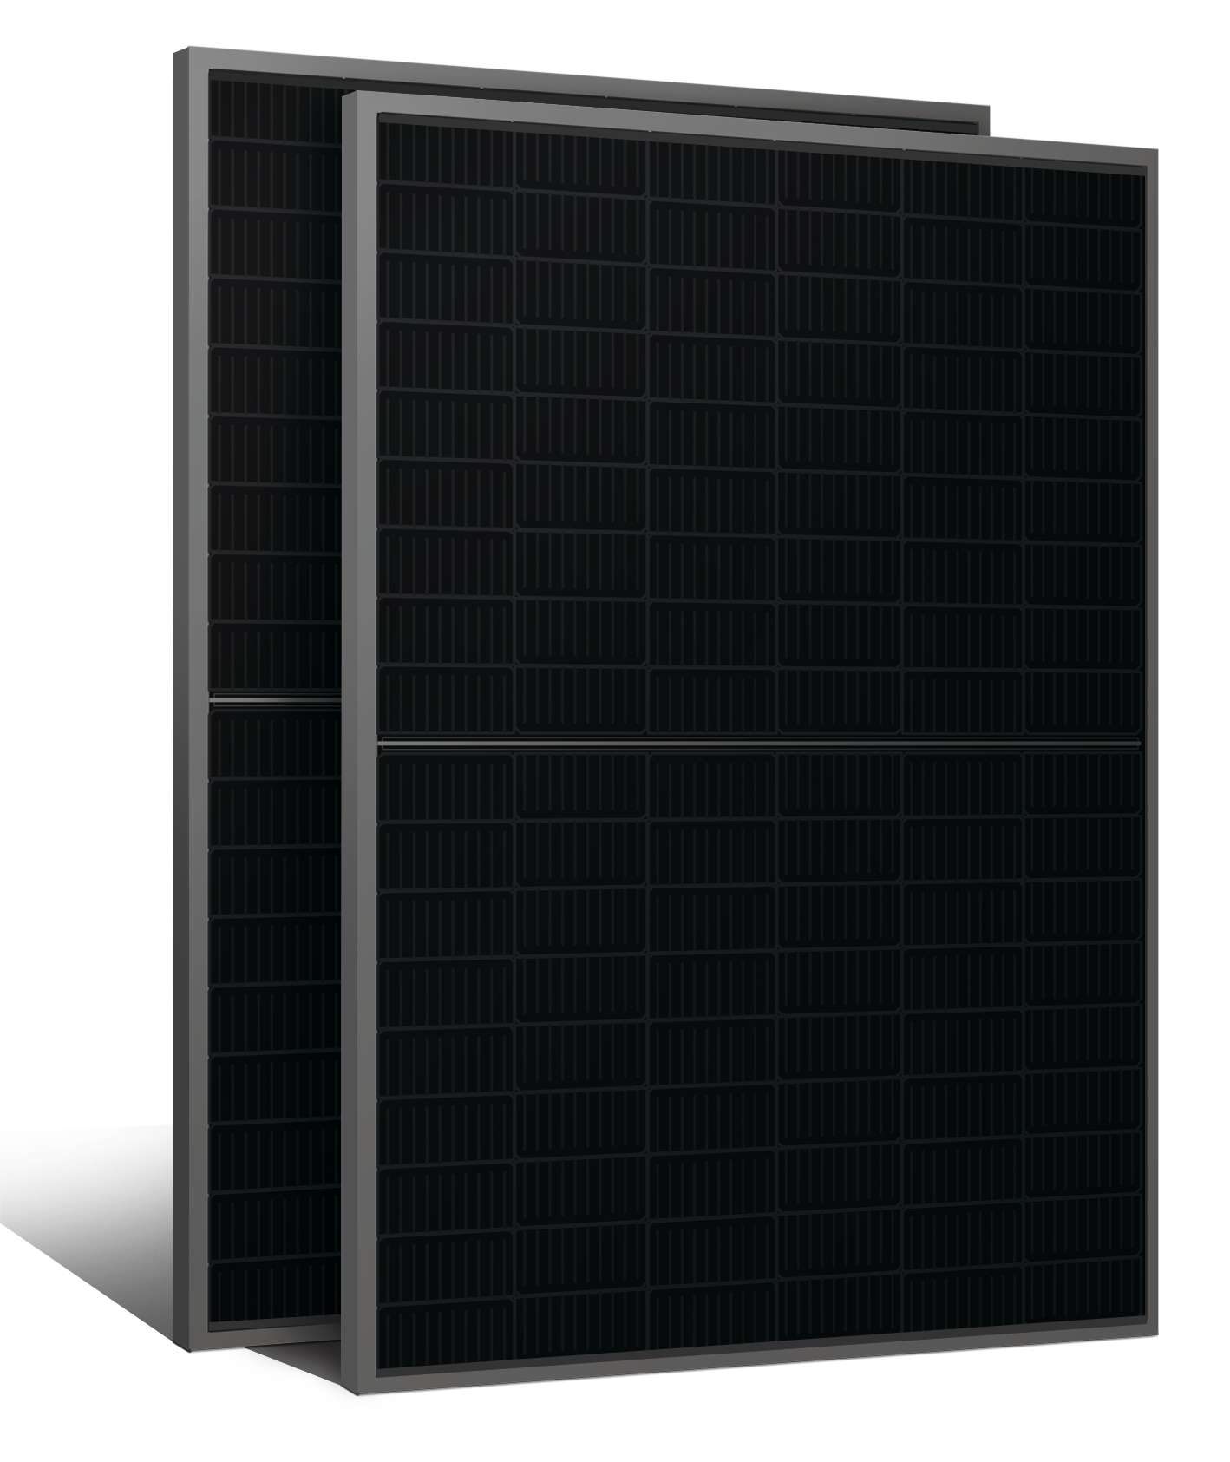











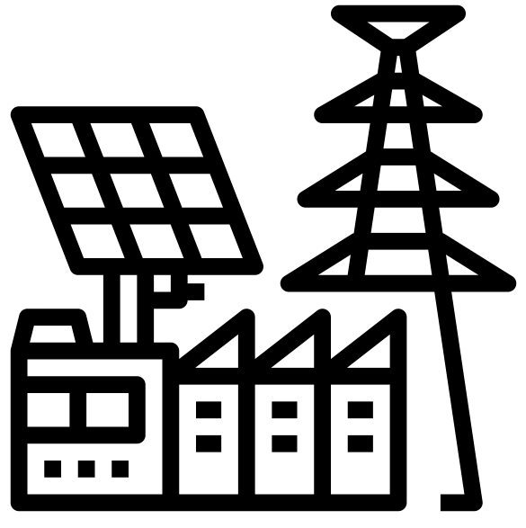








ABS-108GGB-M10
435W – 455W
Topcon Half Cut PV Module
Glass/Glass-Black Frame
455W
MAXIMUM POWER OUTPUT
+10W
OUTPUT POSITIVE TOLERANCE
Guaranteed 0~+10W positive tolerance ensures power output reliability.
23.3%
MAXIMUM EFFICIENCY
KEY FEATURES
LINEAR PERFORMANCE WARRANTY
LOW SYSTEM COST
Higher yield per surface area, lower BOS costs, higher power classes, and an efficiency rate of up to 23.30%.
100%
99%
95%
^{A}DDED VALUE FROM WARRANTY
Guaranteed Power Performance
87.40%
EXTREME WEATHER RATING
High-tech aluminum alloy frame, certified for high snow (5400 Pa) and wind loads (2400 Pa).
90%
85%
80%
1
5
10
15
20
25
30
ADVANCED MODULE TECHNOLOGY
Highest reliability & enhanced crack tolerance MBB module
Product warranty
30
Years
years
30-year Warranty for Extra Linear Power Output
ALL-WEATHER TECHNOLOGY Optimal
Yields, whatever the weather, with low-light and temperature behaviour.
Product warranty
12
Years
12-year Warranty for Materials and Processing (1st year ≤ 1.0%, 2nd~30th years ≤ 0.40% / year)
BETTER TEMPERTURE COEFFICIENT
Lower temperature coefficient (Pmax):
-0.30%/°C, increases energy yield in hot climate
THE IDEAL SOLUTION FOR
PID
ENDURING HIGH PERFORMANCE
Anti LID and Anti PID Technology. Under long-term production safety conditions, the limited power degradation caused by the PID effect is guaranteed.
Residential
Commercial
Off-Grid
Utility
COMPREHENSIVE CERTIFICATES
ADVANTAGES
IEC 61215 | IEC 61730 | IEC 61701 | IEC 62716
MADE IN UAE
Premium products are 100% made in the Emirates.
A RELIABLE INVESTMENT
Products up to 725Wp, 30 years of performance warranty.
ENCOURAGING INNOVATION
Innovative, prestigious, European production technology
UL 61730 | CEC | ISO 9001 | ISO 14001| ISO 45001
Address: Abundance Solar Panels Industries – LLC Plot No 7-8, KHIA5, KEZAD, Abu Dhabi, UAE

Slide 2
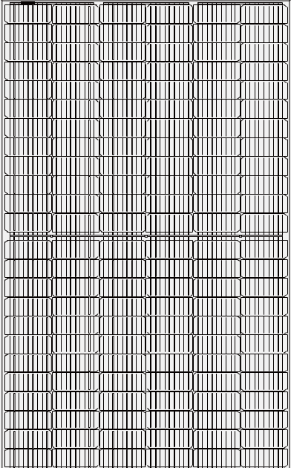

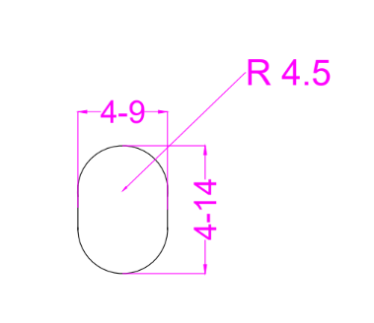

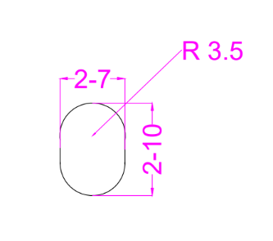
ABS-108GGB-M10-435-455W
ENGINEERING DRAWINGS & TECHNICAL PARAMETERS
ELECTRICAL CHARACTERISTICS (STC/NOCT)
Models | Maximum Rating Power (Pmax) (W) |  | Open Circuit Voltage (Voc) (V) |  | Maximum Power Voltage (Vmp) (V) |  | Short Circuit Current (Isc) (A) |  | Maximum Power Current (Imp) (A) |  | Module Eﬃciency (EFF)(%)
 | STC | NOCT | STC | NOCT | STC | NOCT | STC | NOCT | STC | NOCT
ABS-108GGB-M10-435 | 435 | 325.2 | 38.67 | 36.36 | 33.33 | 31.10 | 14.03 | 11.32 | 13.18 | 10.55 | 22.28%
ABS-108GGB-M10-440 | 440 | 328.9 | 38.80 | 36.48 | 33.45 | 31.21 | 14.08 | 11.36 | 13.29 | 10.64 | 22.53%
ABS-108GGB-M10-445 | 445 | 332.6 | 38.90 | 36.57 | 33.53 | 31.28 | 14.11 | 11.39 | 13.37 | 10.71 | 22.79%
ABS-108GGB-M10-450 | 450 | 336.4 | 38.98 | 36.65 | 33.60 | 31.35 | 14.13 | 11.40 | 13.45 | 10.77 | 23.04%
ABS-108GGB-M10-455 | 455 | 340.1 | 39.08 | 36.74 | 33.69 | 31.43 | 14.14 | 11.41 | 13.52 | 10.83 | 23.30%
*Standard Test Condition (STC): Cell Temperature 25 °C, Irradiance 1000 W/m², AM 1.5, Nominal module operating temperature (NMOT): Air mass AM 1.5, Irradiance 800W/m², temperature 20°C, windspeed 1 m/s. Reduction in eﬃciency from 1000W/m² to 200W/m² at 25°C: 3.5 ± 2%. *Values without tolerance are typical numbers. Measurement tolerance: ± 3%
BI-FACIAL OUTPUT-BACKSIDE POWER GAIN
Models |  | ABS-108GGB-M10-435 | ABS-108GGB-M10-440 | ABS-108GGB-M10-445 | ABS-108GGB-M10-450 | ABS-108GGB-M10-455
10% | Power | 479 | 484 | 490 | 495 | 501
 | Eff | 24.50% | 24.79% | 25.07% | 25.35% | 25.63%
15% | Power | 500 | 506 | 512 | 518 | 523
 | Eff | 25.62% | 25.91% | 26.21% | 26.50% | 26.80%
20% | Power | 522 | 528 | 534 | 540 | 546
 | Eff | 26.73% | 27.04% | 27.35% | 27.65% | 27.96%
25% | Power | 544 | 550 | 556 | 563 | 569
 | Eff | 27.85% | 28.17% | 28.49% | 28.81% | 29.13%
Solar Cell | Topcon 182.2 x 91.88 mm M10 ,16BB
No.of cells | 108 (6×18)
Dimensions | 1722 mm x 1134 mm x 30 mm ( 67.80” x 44.65“ x 1.18” inch)
Weight | 23 kg / 50.70 lbs.(±3%)
Front Glass | 2.0 mm, High Transmission, Low Iron, Tempered ARC Glass
Cell Encapsulation | EPE(Expanded polyethylene) & EVA (Ethylene-Vinyl-Acetate)
Back Glass | 2.0 mm Semi Tempered Glass with Glaze
Frame | Black Anodized Aluminum Alloy Type 6005T6 , Black Color
Junction Box | IP68, 1500VDC, 3 Bypass Diodes
Connectors Type | IP68 MC4 Compatible
Cable | 400mm or 1300 mm, 4mm²
Package Conﬁguration | 36 pcs Per Pallet, 936 pcs per 40’ FT container ( Two pallets=One stack )
CURRENT-VOLTAGE CURVE UNDER DIFFERENT IRRADIANCE

